Slide 1
XSS
Author Name:- Shashi Kant
Inspired by:- Souvik SIr
Date:- 27/12/2018
Now before starting let’s see what XSS is--
Cross-site scripting, also known as XSS, is a type of computer security vulnerability typically found in web applications. XSS enables attackers to inject client-side scripts into web pages viewed by other users. A cross-site scripting vulnerability may be used by attackers to bypass access controls such as the same-origin policy. Cross-site scripting carried out on websites accounted for roughly 84% of all security vulnerabilities documented by Symantec as of 2007. Bug bounty company HackerOne in 2017 reported that XSS is still a major threat vector. XSS effects vary in range from petty nuisance to significant security risk, depending on the sensitivity of the data handled by the vulnerable site and the nature of any security mitigation implemented by the site's owner.

Slide 2
We perform the following tests on a XSS-lab website :
http://leettime.net/xsslab1/

Slide 3
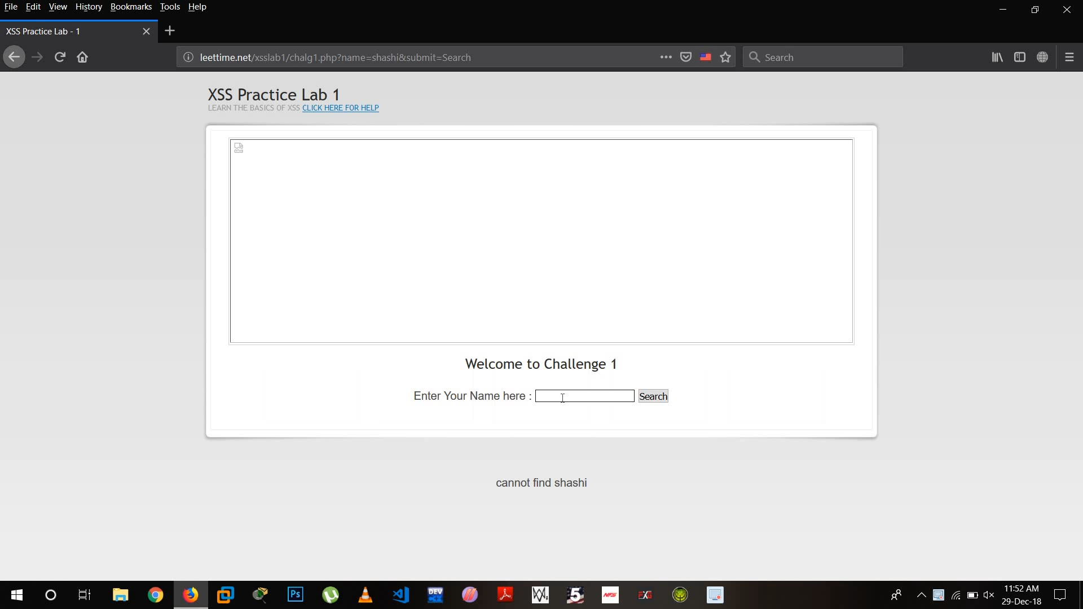
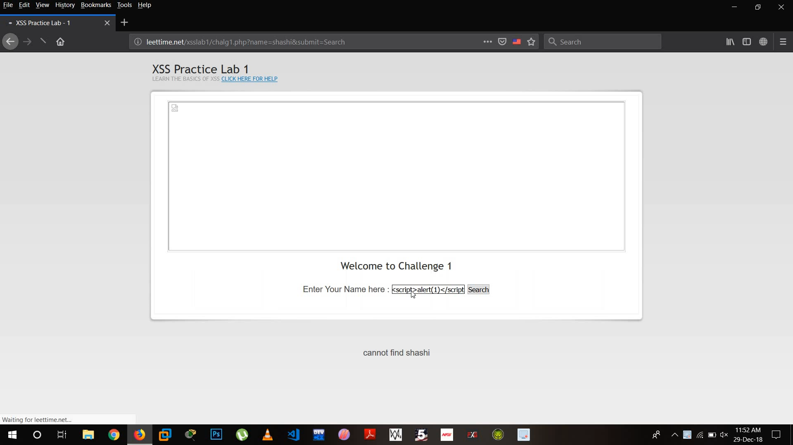
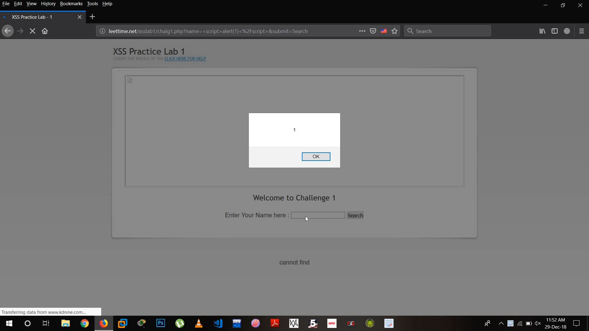
Challenge 1:
Step 1:
Enter something. Here it reflects back the input.
Step 2:
Use a javascript code – <script>alert(1)</script>
Step 3:
It is executed successfully.

Slide 4
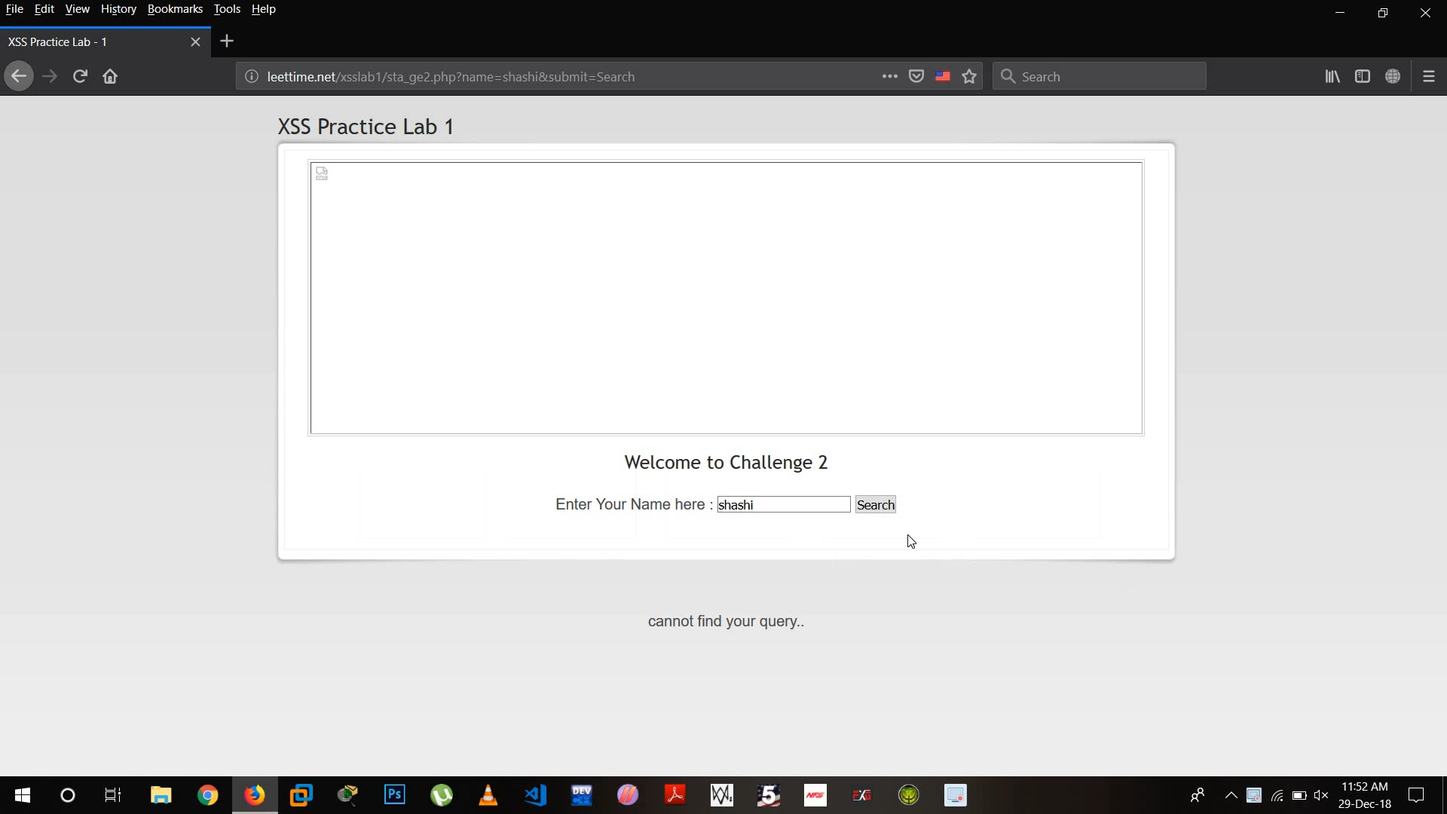
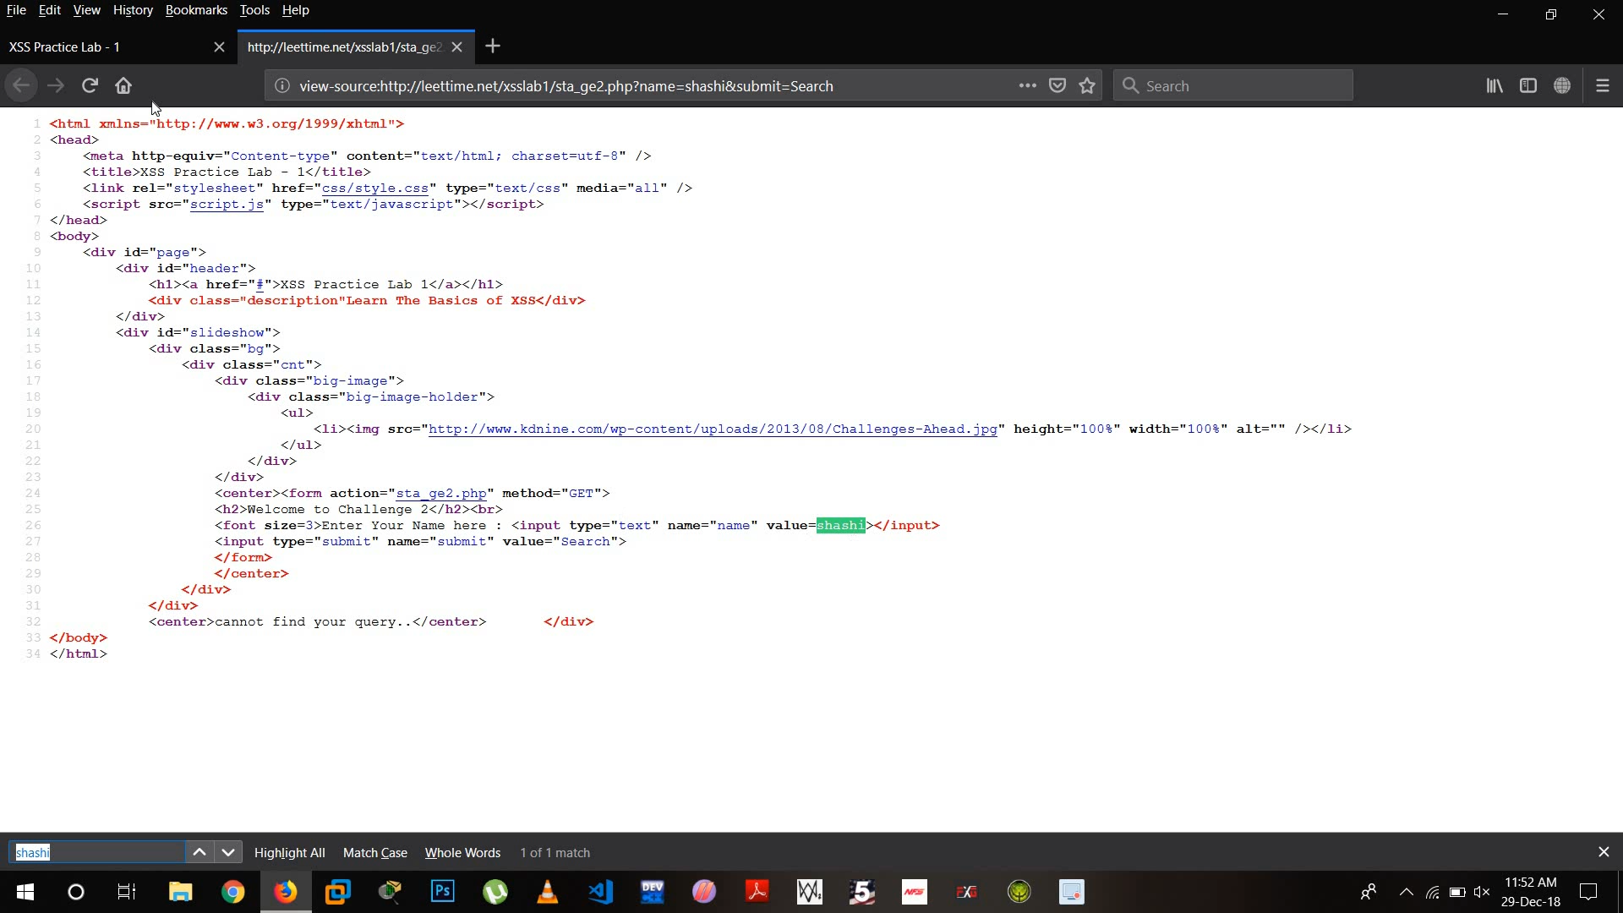
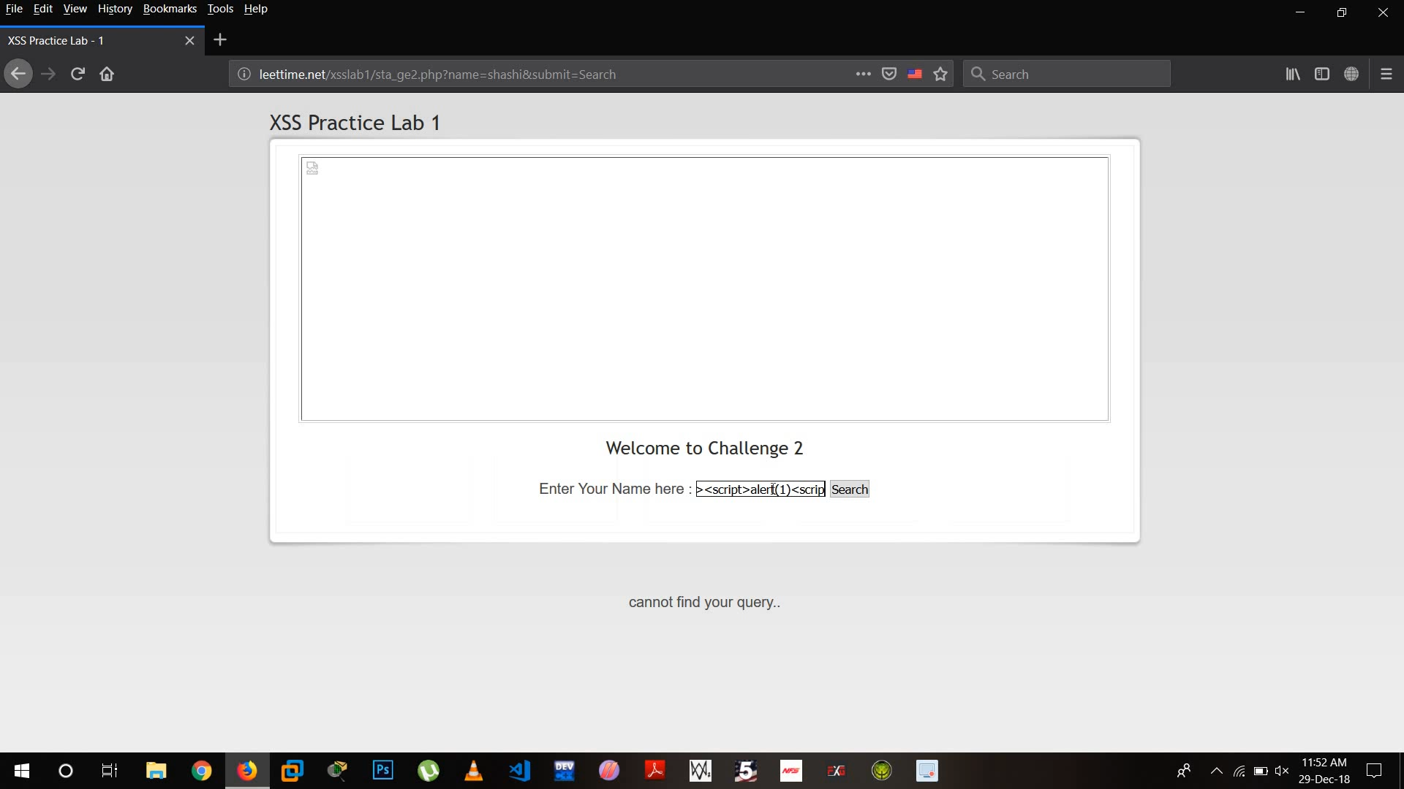
Challenge 2:
Step 1:
Enter something. Now if it does not reflects our input, go to View Source code.
Step 2:
See where the input is present. In our case it is enclosed within <>.
Step 3:
Our new payload will be-
><script>alert(1)</script>

Slide 5
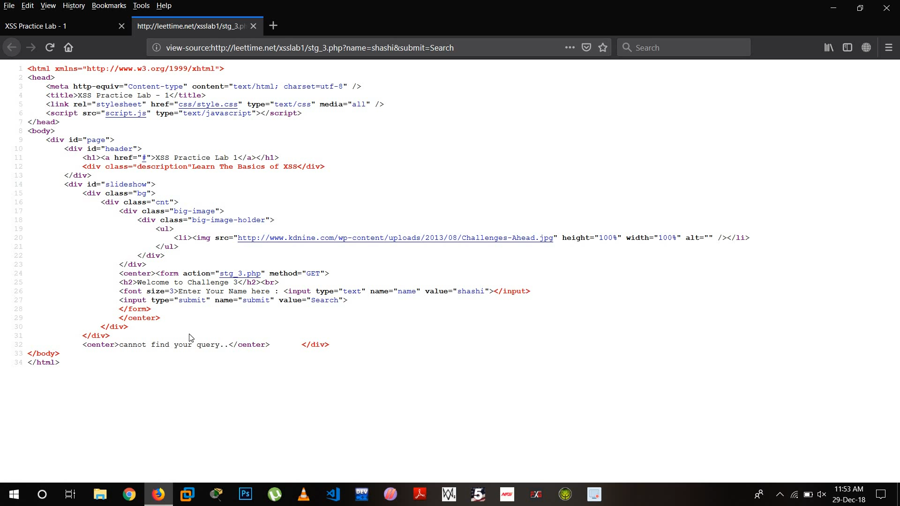
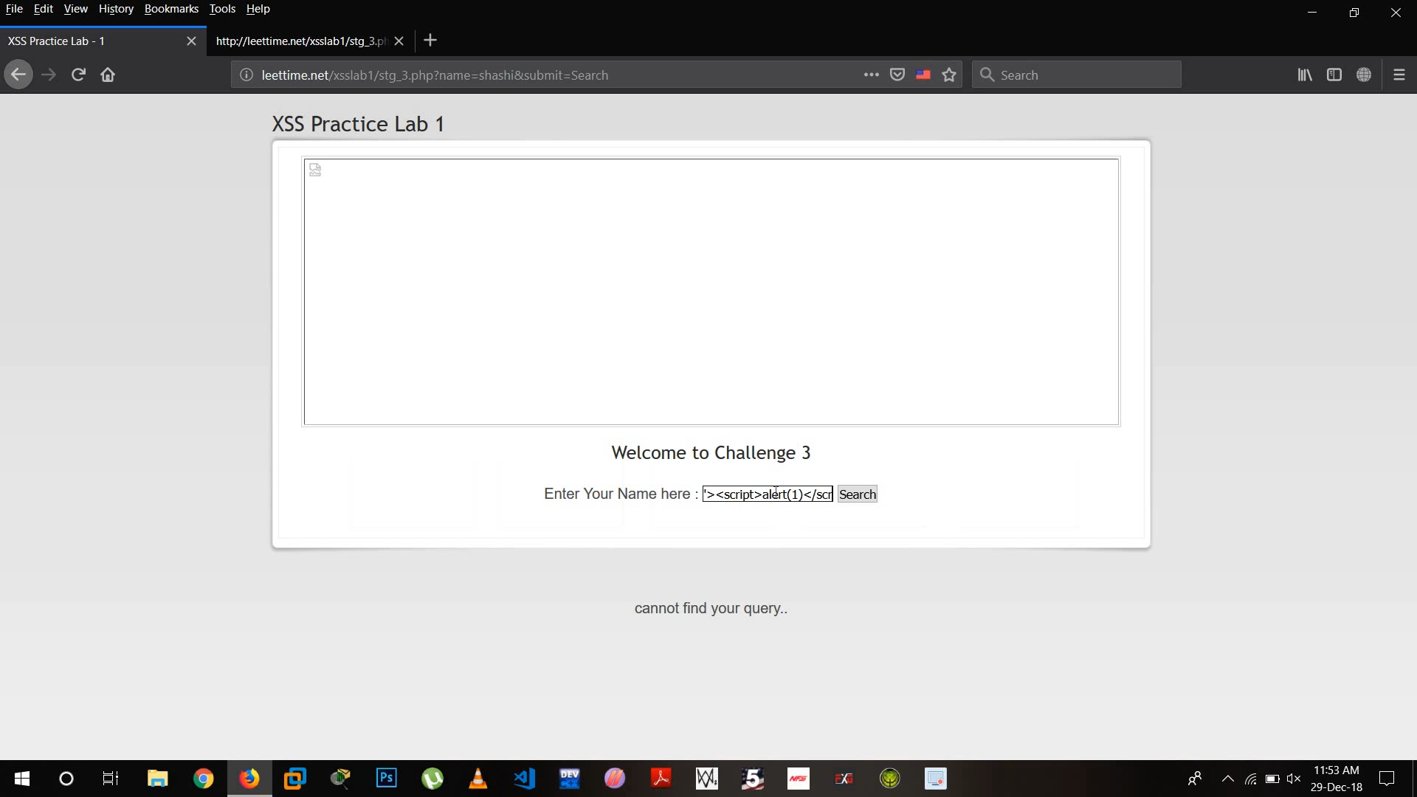
Challenge 3:
~In this challenge, we go to source code to find out that the input is present in “”.
~Hence, our payload must close the “. So our payload would be – “<script>alert(1)</script>

Slide 6


Challenge 4:
~In this challenge, we go to source code to find out that the input is present in ‘’.
~Hence, our payload must close the ‘. So our payload would be – ‘<script>alert(1)</script>

Slide 7
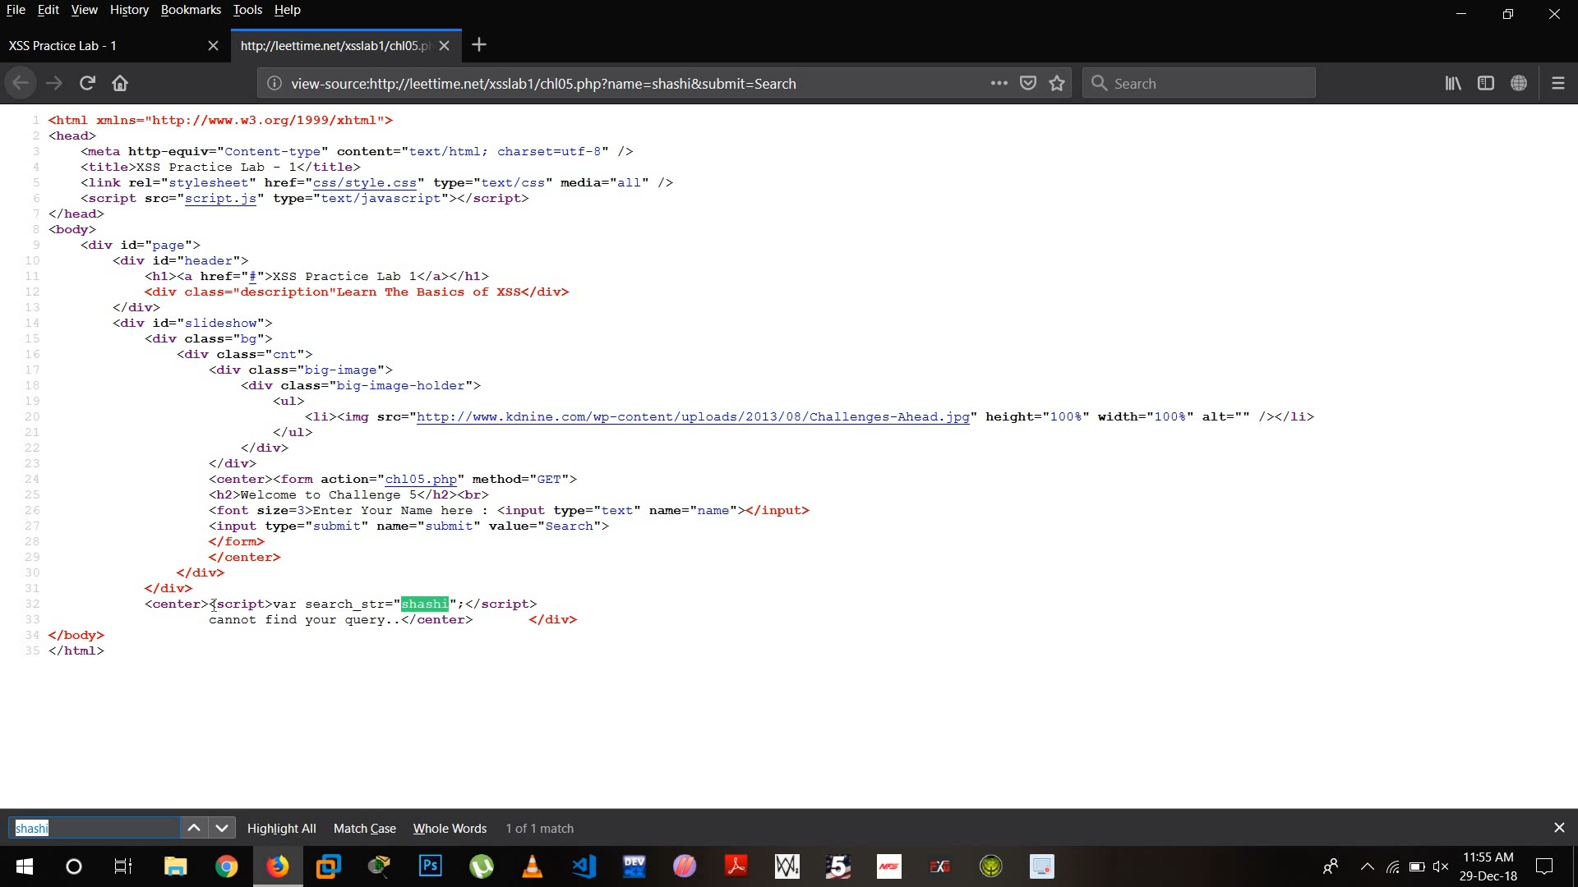
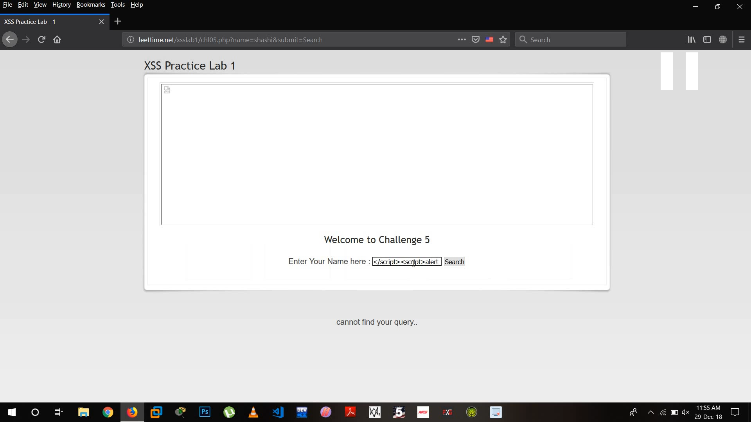
Challenge 5 & 6:
~In this challenge, we go to source code to find out that the input is present in <script> tag.
~Hence, our payload must close the <script> tag.
So our payload would be – </script><script>alert(1)</script>

Slide 8
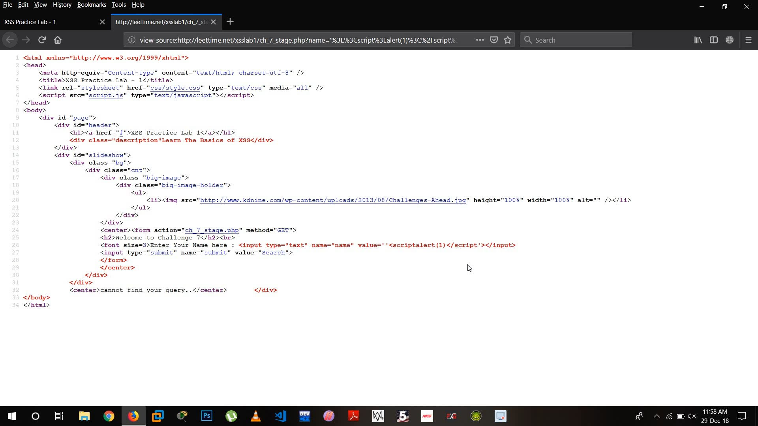

Challenge 7 & 8:
We go to source code to see why our payload did not work.
When keyboard input becomes a string value we use onmouseover=alert(1) payload which is used to give input through mouse.
Hence, in this case our payload is ‘onmouseover=‘alert(1) – since the input is enclosed within ‘’
Now, after we use the payload we need to move to mouse cursor to the input field to make our payload because it takes input through mouse.

